Slide 2
Objectives
Understand the purpose and use of an instruction set for a CPU
Understand what is meant by a microprocessor
Describe the purpose and characteristics of an embedded system
Be able to identify devices which commonly use embedded systems

Slide 3
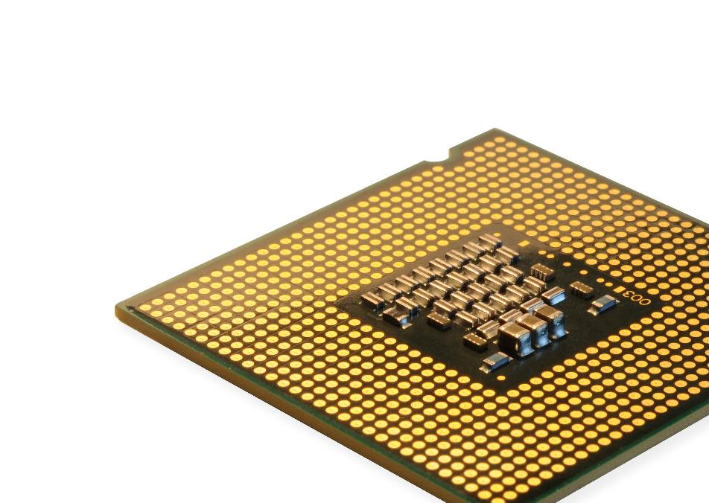
Starter
CPUs fetch, decode and execute instructions
In a high level language, you may program an instruction such as
total ← 0 FOR i ← 1 TO 10 DO total ← total + i ENDFOR
What sort of instructions does a CPU actually use?

Slide 4
Starter
CPUs use very simple instructions known as machine code or assembly language
A high level instruction such as total ← 0 may use an instruction such as LOAD ACC, #0
Harder instructions are broken down into simpler assembly code instructions
For example, FOR i ← 1 TO 10 DO may need several instructions to move data between RAM and the Accumulator

Slide 5
Instruction sets
Instruction sets are all the possible instructions that are able to be decoded and executed by a CPU
A particular CPU will have its own instruction set
Programs written for one type of CPU won’t work on another
For example, a program written for an Intel Core i7 won’t work on an ARM processor contained in a smartphone

Slide 6
Operators and operands
In ordinary Maths and programming we use the words operator and operand
An operator performs an operation (calculation) on the operand(s)
The operands are the values used
5 | + | 7
Operand | Operator | Operand

Slide 7
Opcodes and operands
When programming a processor a special language called assembly code is used
The program is then assembled into a binary form known as machine code – this is what is run by the processor
The assembly code (and machine code) make use of opcodes and operands
The opcode is the instruction and the operands are the values that the instruction works on
Instruction: | STO | 057 | ACC
 | Opcode | Operand | Operand
 | Store… | …into memory address 057… | …the contents of the accumulator

Slide 8
Worksheet 3
Complete Task 1 on Worksheet 3

Slide 9
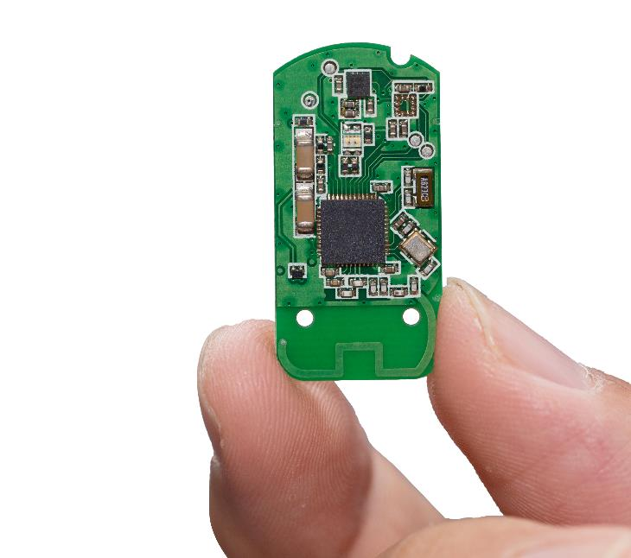

Microprocessor
A microprocessor is an integrated circuit that is all contained on a single chip
CPUs are one type of microprocessor, they include Pentium microprocessors and ARM microprocessors
Microcontrollers contain not only the microprocessor, but also RAM and ROM or flash memory for volatile and non-volatile storage – this allows for an entire computer to be contained on one chip

Slide 10
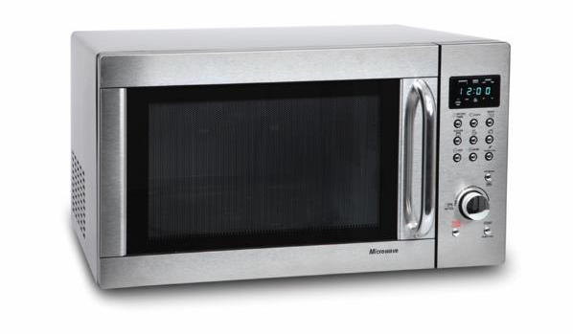

Embedded systems
Do these devices have inputs, processes and outputs?
Could they be classed as computers?
Why or why not?

Slide 11
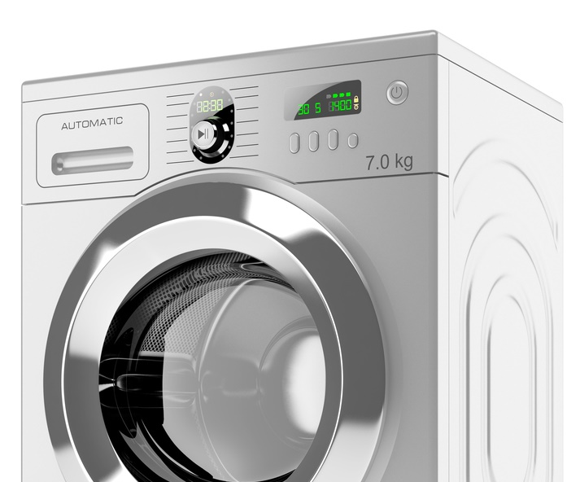
Embedded computers
An embedded computer is a single microprocessor that includes RAM, ROM and a CPU
An embedded computer is frequently used to control a device using simple inputs

Slide 12
Embedded systems
Without embedded systems, a digital device would not be able to perform specific functions
For example, a dishwasher wouldn’t know when to heat the water, or a satnav wouldn’t know how to communicate with a satellite
What embedded functions do cars use?

Slide 13
Car embedded systems
Some examples of embedded systems in cars include:
Cruise control
Engine cooling fan
Interior fans and temperature
Interior lighting
Rear cameras and remote parking
Infotainment systems (entertainment / information / satnav)
Engine control unit (ECU)

Slide 14


Other embedded systems
Embedded systems are also used in:
Security systems
Lighting systems
Vending machines

Slide 15
Embedded vs General purpose
The following table shows how the characteristics of embedded systems compare to general purpose machines
Characteristic | Embedded system | General purpose machine
CPU speed | Typically slow | Typically very fast
Software | Has one purpose and cannot install new software | New software can be installed
Storage | Programs stored on ROM | Programs stored on hard drives
Reliability | Typically very reliable – e.g. a microwave should not have a bug that changes defrost to full power | As it runs many software programs it may be less reliable and need restarting the device

Slide 16
Worksheet 3
Complete Task 2 on Worksheet 3

Slide 17


Plenary
Work with a partner to explain the following terms:
Embedded system
Microprocessor
Instruction set
Assembly code
Machine code
Opcode and operands

Slide 18
Plenary
Embedded system – a single processor that includes, RAM, ROM and processor as one unit
Microprocessor – a type of integrated circuit on a single chip
Instruction set – a list of all the commands that can be processed by a CPU
Assembly code – code written in assembly language. The instructions written are exact 1:1 representations of the machine code that will be executed on the CPU
Machine code – The binary representation of the assembly code program. This will be executed by the CPU
Opcode and operands – The opcode is the instruction and the operands are the values that the instruction works on

